Slide 1

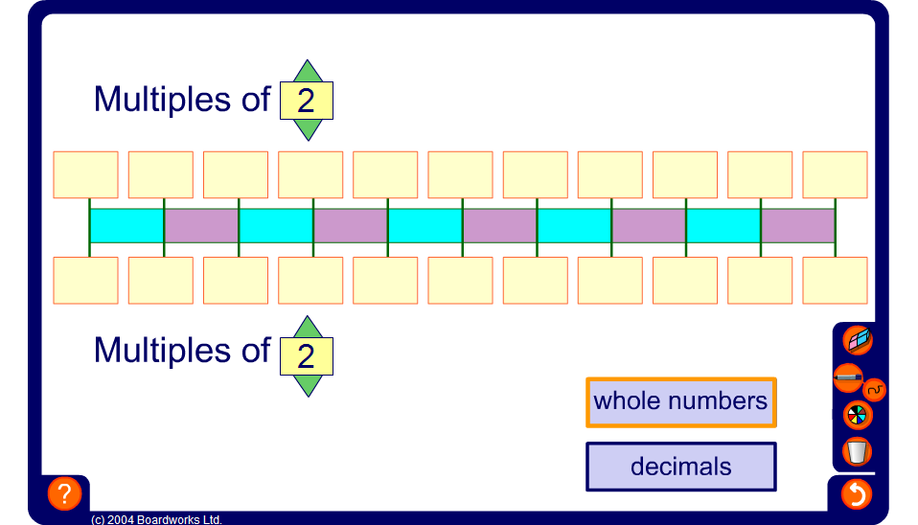


Proportional sets
Notes:
Select a step size for the numbers on the top row and another for the numbers on the bottom row. Reveal the numbers and chant proportional pairs. For example, select a step size of 9 on the top row and 3 on the bottom row.
Chant 0, 0; 9, 3; 18, 6; 27, 9; 36, 12 and so on.
Ask pupil to tell you the relationship between the number on the top and the corresponding number on the bottom. For example, the number on the bottom is always a third of the number on the top. Ask pupils to tell you any other pairs of numbers that would belong to this set. For example 30 and 10, 1.2 and 0.4 or 321 and 107.
Describe the numbers along the top of the counting stick as being directly proportional to the numbers along the bottom.
State that when two sets of numbers are in direct proportion the ratio between any given pair of numbers in the set is constant (the same).
Repeat for other proportional sets.
Extend the activity by selecting decimal step sizes.
Ask pupils to give you a proportional pair that lie between two of the pairs given on the board.

